Slide 1


POLITECNICO DI MILANO
Inclusive Digital Technology
Exclusion Identification
Team
Rishabh Tiwari
Monica Pantofaru
Eleonora Bellè
Mille Kåge
APRIL 4, 2024

Slide 2

POLITECNICO DI MILANO
Agenda
Introduction
Website Selection
Functionalities and Methodologies
The Persona
The impairments
Living a life of the persona in reality
Conclusion

Slide 3

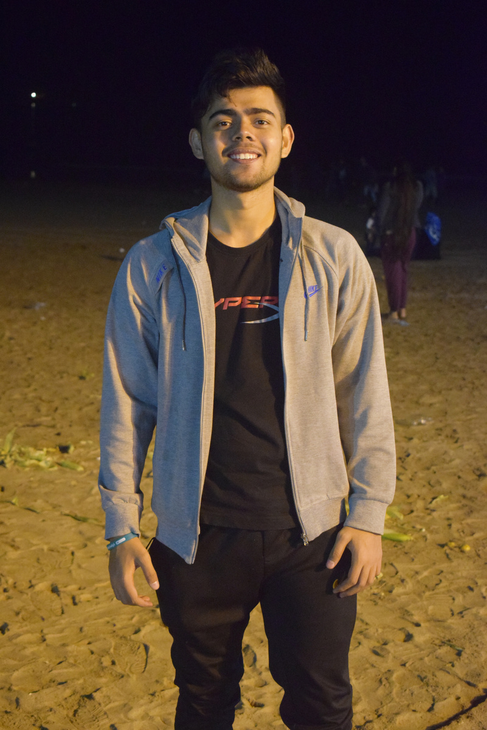

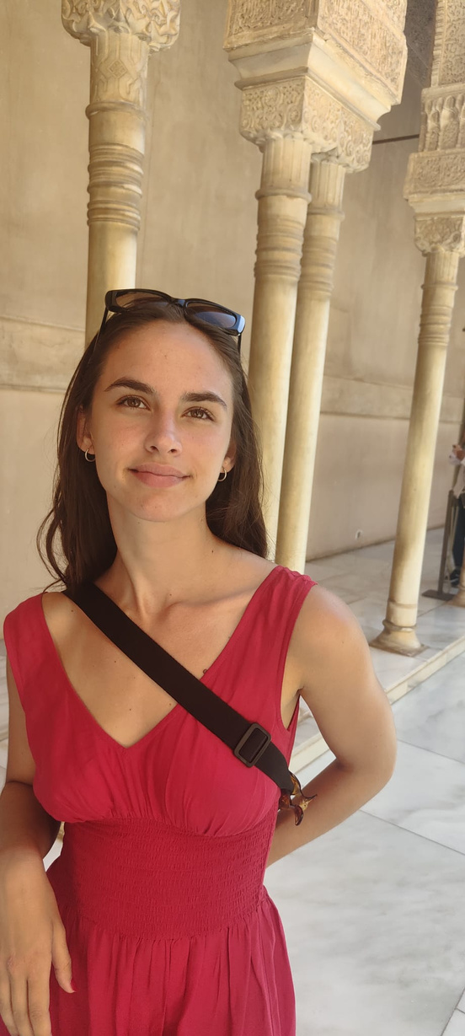
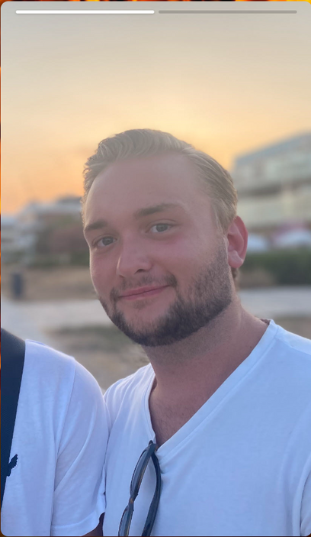
POLITECNICO DI MILANO
Our Team
Rishabh Tiwari
Monica Pantofaru
Eleonora Bellè
Mille Kåge

Slide 4
POLITECNICO DI MILANO
Introduction
What is Exclusion identification?
A methodology to recognize and determine individuals or groups being excluded.
Exclusion from participating in certain activities, benefits, services, or opportunities that are available to others.
What is the context?
This can occur in social, economic, political, educational, health-related areas and others.
Why is it important?
For developing targeted interventions, policies, and programs
aimed at reducing disparities
It ensures equity and inclusion for all members of society with several disabilities

Slide 5

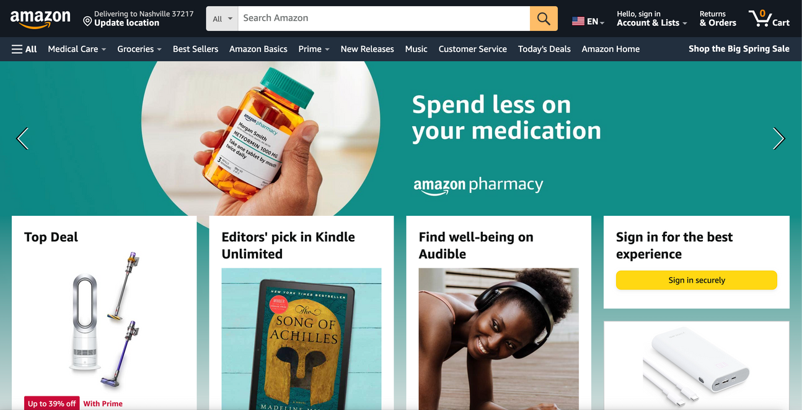
Why Amazon.com?
Website Selection
Extremely popular (around 310 million active users)
Hard to use from personal experience
It‘s importa﻿nt for this website to be accessible
Amazon.com

Slide 6
Amazon functionalities
Sign u﻿p form | Crea﻿te an account to be able to make an order
Search an﻿d filter | Find the product you want to buy
Purchase the produ﻿ct | Go through the chec﻿kout and make the order
Return the product | Possibility to return a product if not satisfied

Slide 7





Methodology for Analysis
Understanding WCAG Guidelines
Web Developer
Extension
Easy
Checks
Manual Inspection
Screen Reader Testing

Slide 8


Emily Johnson
Age: 29 yr
Occupation: Freelance Graphic Designer
Location: Milan, Italy
Passions:
Emily loves drawing and designing cool stuff.
She a big fan of books and new art supplies.
Impairments:
Emily has trouble seeing like most people because of a condition she has called retinitis pigmentosa.

Slide 9
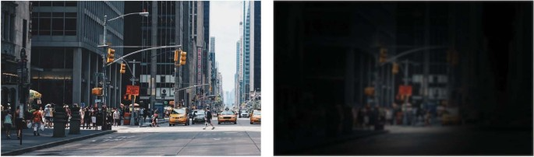

Retinitis Pigmentosa
Retinitis pigmentosa (RP) is a genetic disorder primarily affecting the retina, the light-sensitive tissue lining the back of the eye. This condition leads to progressive vision loss and can eventually result in blindness.
Common symptoms of RP include:
Color Vision Deficiency
Decreased Visual Acuity
Tunnel Vision
Night Blindness

Slide 10


Technologies
Emily uses these tools:
Screen reader
Keyboard navigation
Increased contrast

Slide 11

Spotting the Roadblocks
 | Missing Alt Text for Images
 | Cluttered Layout
 | Inconsistent Focus Indication
 | Insufficient Color Contrast

Slide 12
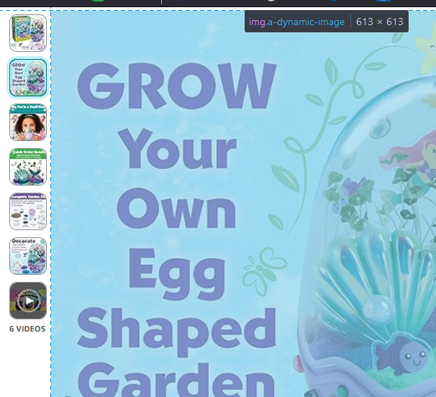
Missing Alt-text

Slide 13
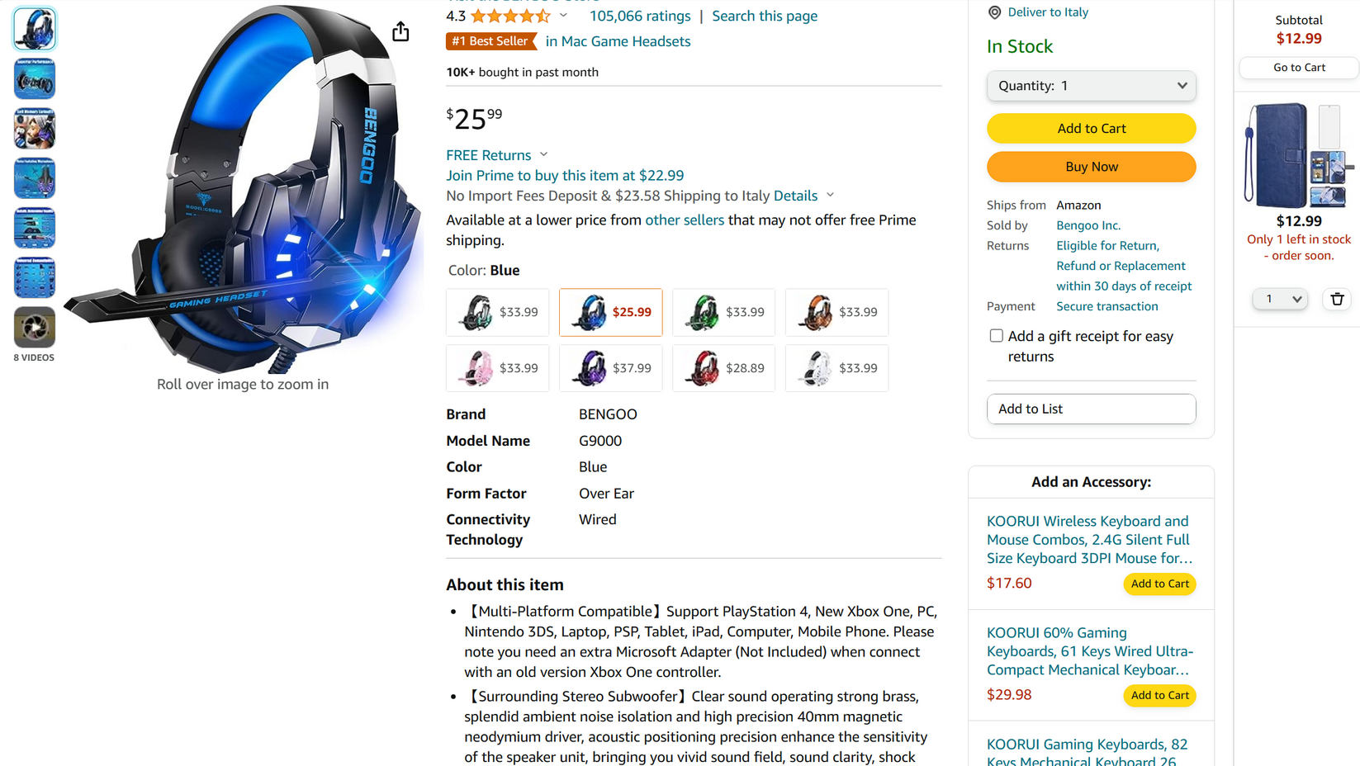
Cluttered Layout

Slide 14
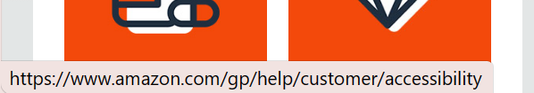
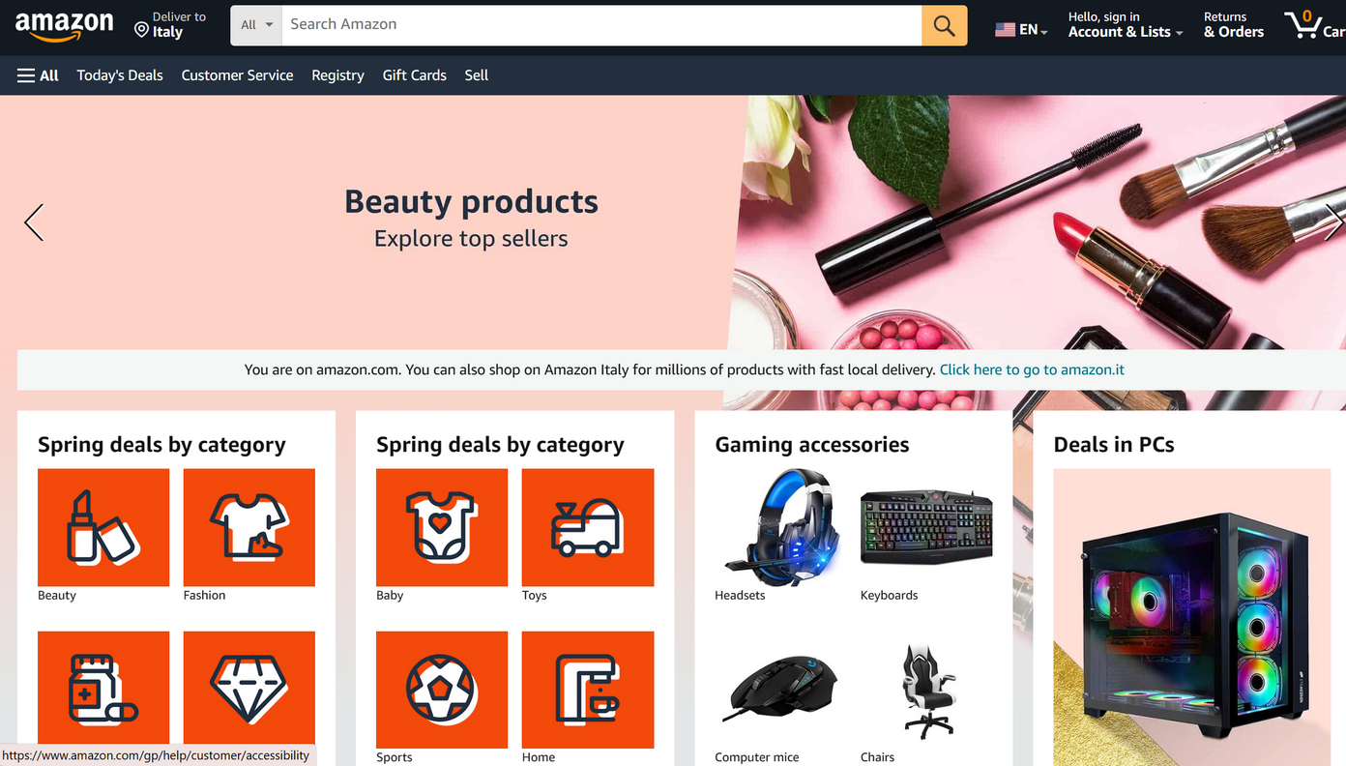
Inconsistent Focus Indication

Slide 15
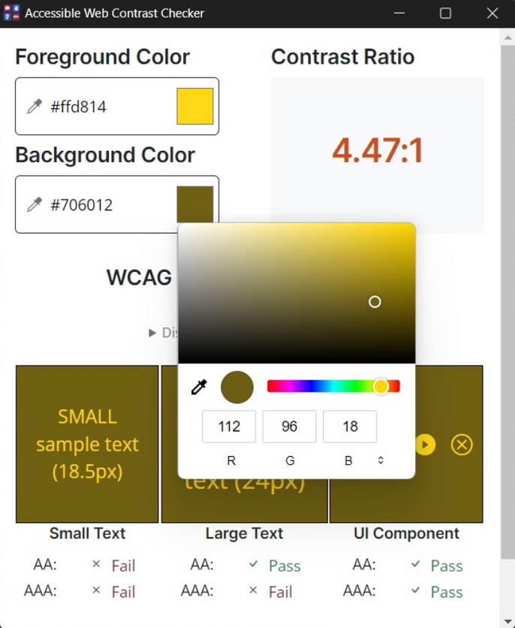
Insufficient color contrast

Slide 16


A Day in Emily’s Shopping Shoes
she tries to pick a shipping option, but her keyboard cannot find its way;
the focus is invisible.
Emily finds the perfect art book on Amazon.
As she navigates, she hits a wall – no descriptions on extra images. She is unsure
what is in her cart.
And those light grey buttons? They might as well be
camouflaged.

Slide 17

POLITECNICO DI MILANO
Conclusion
Why is web accessibility important?
Possible solutions
Alt text
Clear keyboard navigation
Improving contrast ratios
Artificial Intelligence integration

Slide 18

POLITECNICO DI MILANO
Thank you!
Do you have any questions?

